Slide 1
Data Science Methods for Clean Energy Research
Week 1 , Lecture 1: Class introduction
January 4, 2017

Slide 2
Outline
Course overview
Discussion of HW1
What is Data Science?
Introduction to data science through examples

Slide 3
Course overview and goals
Who am I?
Some additional details (logistics)
Course format (what to expect)
Students who complete this class will:
Have a basic overview of statistical reasoning and method (esp. distributions, hypothesis testing and error analysis)
Basic introduction to data visualization methods
Introduction and hands on experience to a variety of machine learning (ML) methods esp. in context of advanced materials for clean energy
Basic introduction to data management

Slide 4
HW 1
Description of HW 1
Two options
Should not take too long!
See class website

Slide 5
What is Data Science?
Goals:
Explain to Grandparents what is Data Science
Defend against cranky people who claim there is, “nothing new about Data Science” or, “I was already doing that about 20 years ago!”
Explain to people in your own discipline (i.e., your domain) why Data Science matters and what are relevant data-related challenges

Slide 6
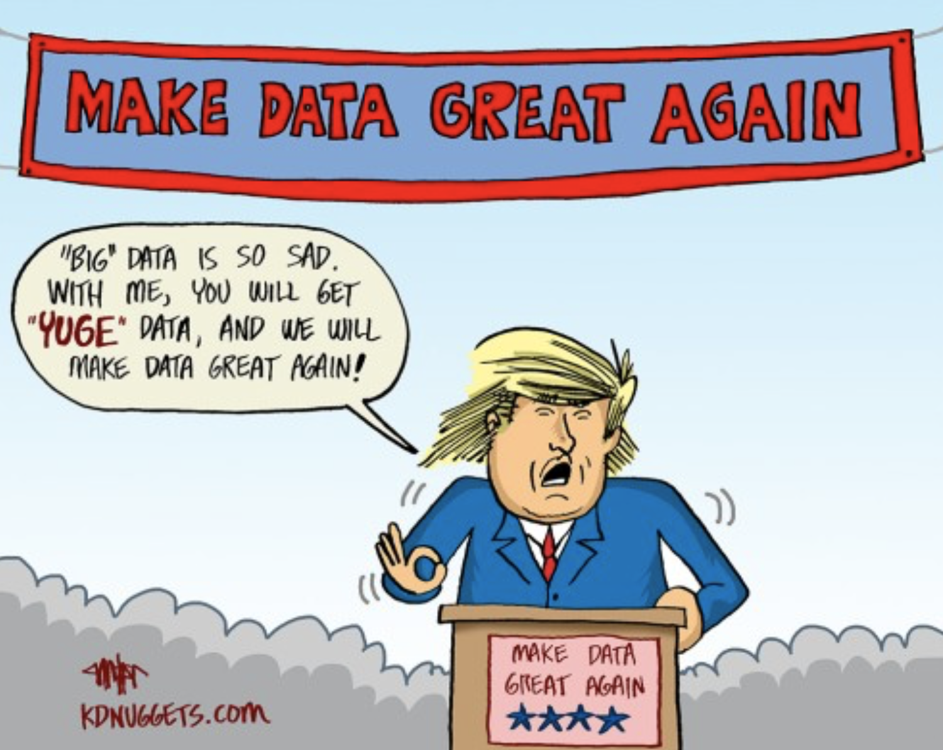
Too soon?

Slide 7
Data Science in your own words...
Alone: Define Data Science by answering as many of the following questions as you can (write or type your answer)
What is Data Science?
What/who is a data scientist?
Why is Data Science a thing all of a sudden?
Why does Data Science matter, broadly, in my field of [insert]?
Why does Data Science matter, specifically, in my sub-discipline of [insert]?
~5 min working alone – take some notes!

Slide 8
Data Science in your own words...
At your tables:
Introduce yourselves (1st names and departments)
Appoint 1 facilitator (soonest birthday, e.g. today) and 1 scribe (farthest birthday, e.g., yesterday)
Go around the table, each person answers each question, then move onto next question → OK if you didn’t answer something
What is Data Science?
What/who is a data scientist?
Why is Data Science a thing all of a sudden?
Why does Data Science matter, broadly, in my field of [insert]?
Why does Data Science matter, specifically, in my sub-discipline of [insert]?
~10 min (I will flex time as needed)

Slide 9
Data Science in Jim’s words...
My answers (subject to change at any time ☺ )
What is Data Science?
The systematic use of algorithms to manage, manipulate or visualize data sets sufficiently large that traditional methods are rendered useless
Caveat emptor: what does traditional mean…
What/who is a data scientist?
A scientist or engineer equipped with at least basic skills in the areas of data management, visualization and (statistics or machine learning)
Why is Data Science a thing all of a sudden?
55% recognition of missed opportunities, 35% increased availability of algorithms and 10% hype

Slide 10
Data Science in Jim’s words...
My answers (subject to change at any time ☺ )
Why does Data Science matter, broadly, in my field of Chemical Engineering?
Why does Data Science matter, specifically, in my sub-discipline of Computational Molecular Science?
^ See HW 1 ;)

Slide 11
Explain Data Science to an elder
At your tables:
The person whose first name starts with the letter closest to “Q” is the scribe. [Tie break (e.g., Paul and Rob): who has darker colored hair]
5-10 min for the group to agree on how to respond to this scenario: you are at a family party and an older family member is making small talk, trying to avoid talking about your research or why you are still in school. DIRECT comes up and they say “Ohhhh Data Science, I heard about that on Dr. Oz. What is it?”
“Aunt Mae, that is a great question. Data Science is …”
Each team should first pick a hero. This should be easy because everyone wants to be a hero, right?
Together we will randomly select a few heroes to share their answers

Slide 12
How’d we do?
2 presentations
(2 more if time)
Group feedback in Slack

Slide 13
Introducing Data Science Through Examples
Jim Pfaendtner
Week 1 – Lecture 1

Slide 14
Topics
A bit about the Materials Genome Initiative and three major outcomes
Examples in pillars or areas of Data Science
Data management
Data visualization
Statistics and machine learning

Slide 15
The MGI and materials data science
Major joint effort by funding agencies in the US to support discovery of new materials by developing
Data sets
Mathematical modeling tools
New visualization approaches
Not specific to clean energy, but many projects have been focused on PV / battery

Slide 16
MGI strategic goals and activities
Facilitate Access to Materials Data
Enable a Paradigm Shift in Materials Development
Especially via experimentally-validated predictive materials modeling
Equip the Next-Generation Materials Workforce
Integrate Experiments, Computation, and Theory
Especially through the support of cyberinfrastructure development and open sharing of data

Slide 17
Three examples of highly successful MGI projects: Harvard Clean Energy Project
Cue promotional video...
The CEP seems to be winding down…
At its peak it probably calculated theoretical properties for over 30 million candidate molecules for OPV applications
Where did the input structures for the quantum calculations come from?
HCEP PI: Alán Aspuru-Guzik, Harvard

Slide 18
Three examples of highly successful MGI projects: Materials Project
About: By computing properties of all known materials, the Materials Project aims to remove guesswork from materials design in a variety of applications. Experimental research can be targeted to the most promising compounds from computational data sets. Researchers will be able to data-mine scientific trends in materials properties. By providing materials researchers with the information they need to design better, the Materials Project aims to accelerate innovation in materials research.
Text from materialsproject.org
MP PI: Gerbrand Ceder, Berkeley

Slide 19
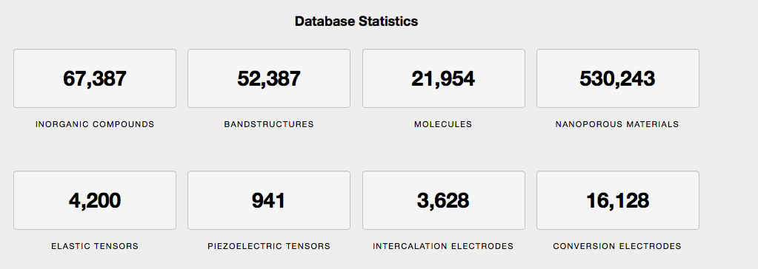
Three examples of highly successful MGI projects: Materials Project
Progress so far
Notice any differences between this and HCEP?
Cue a brief exploration of Materials Project
Preview what is to come (learning the MP API!)

Slide 20
Three examples of highly successful MGI projects: Open Quantum Materials Database
Similar in spirit to HCEP and MP. (link to OQMD)
OQMD focuses on hypothetical materials like HCEP focuses on hypothetical molecules
Great API and downloadable database
OQMD is also on twitter!
OQMD PI: Chris Wolverton, Northwestern

Slide 21
Topics
A bit about the Materials Genome Initiative and three major outcomes
Examples in pillars or areas of Data Science
Data management
Data visualization
Statistics and machine learning

Slide 22
What’s up next week
Monday: Data visualization in python notebooks
Wednesday: Introduction to statistics

